Slide 1
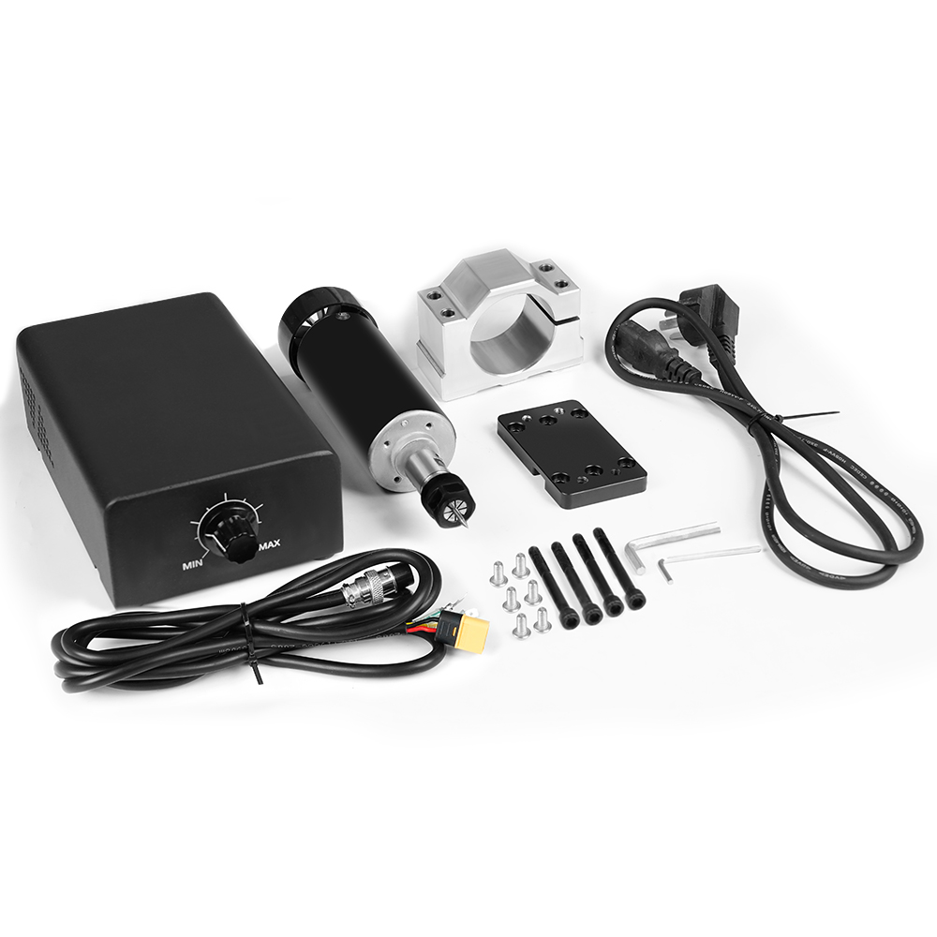
500W Cold Air Spindle Motor Kit

Slide 2
500W Cold Air Spindle Motor Kit
Spindle Motor: Brand new brushless DC motor
Operating Voltage: 48VDC requires a brushless driver for operation
Peak Power: 500W
No-load Speed: 12000r/min
Peak Torque: 0.6 (N.m)
Insulation Resistance: >2 Megaohms
Dielectric Strength: 400V
Motor Total Length: 199mm (including fan, clamping parts, and motor)
Spindle Net Weight: 1.4KG
Radial Runout: Approximately 0.01-0.03.
Can be used for engraving metals or non-metals, etc.
This spindle comes with forced air cooling and can operate for long periods.
With packaging dimensions: 250*250*91mm
With packaging weight: 3kg

