Slide 1
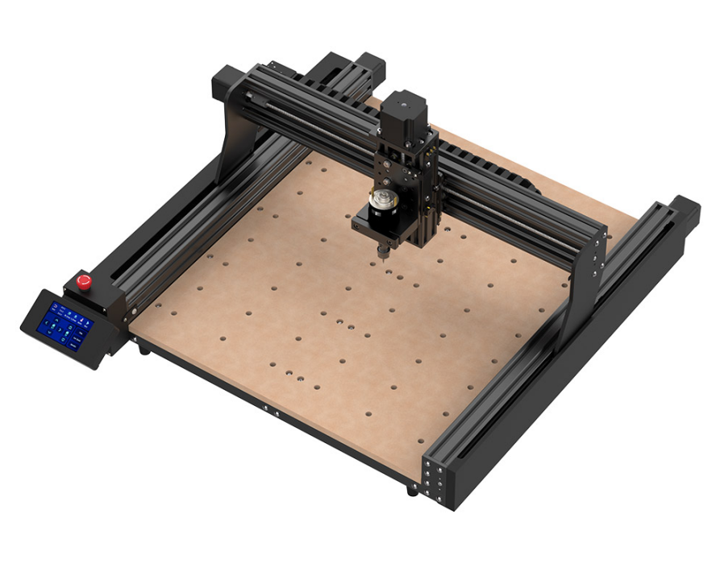
TTC450

Slide 2
Product Description
TTC450
Brand: TWO TREES
Model: TTC-450
Engraving Area: 460mm x 460mm x 80mm
Power Adapter Power: 120W, 5A, 24V
Spindle Parameters: 24V 5A, 775 motor 8000RPM
Tool Setting: Software control
Control Board Compatibility: GRBL
Maximum Engraving Speed: MAX 800mm/min
Limit Switches: Dual limit switches for X, Y, Z axes + ESTOP
Engraving Accuracy: 0.01mm
Stepper Driver: A4988 1.3A (other drivers can be externally connected to the mainboard)
Linear Drive: Built-in POM wheels
Stepper Motor: NEMA 23 (2-phase, 1.5A) with a torque of 20mN.m
Transmission Type: T8 lead screw with 2mm pitch and 4mm lead
Y-axis: Dual Y-axis with built-in rollers
Emergency Stop Switch: Available
Mainboard: Utilizes ESP32 high-integration, low-power chip for high stability and reliability. Offers ultra-high processing speed and large memory, supports offline controller, four axes, and PWM laser signal.
Cable Management: XY drag chain
Machine Weight: 19.2kg
Shipping Weight: 20kg
CAM Software: Control: Candle
Programming: CarvecoMaker, Artcam, Easel
Operating System: Windows XP/7/8/10, MAC OS
Engraving Materials: Suitable for engraving and cutting MDF, PVC, acrylic, solid wood, particleboard, plywood, organic board, epoxy resin, nylon, PCB, aluminum, copper, carbon fiber board, etc.

