Slide 1
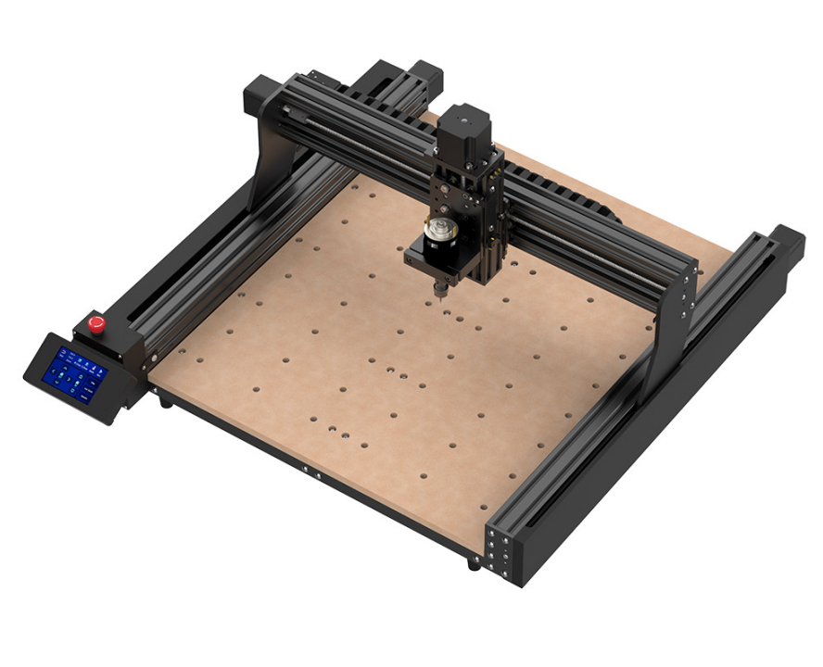
TTC450

Slide 2
产品描述
TTC450
品牌 TWO TREES
型号 TTC-450
雕刻区域 460mmX460mmX80mm
电源适配器功率 120W，5A，24V
主轴参数 24V 5A，775电机8000RPM
对刀方式 软件控制
控制板兼容性 GRBL
雕刻速度MAX MAX800mm/min
限位开关 X、Y、Z三轴双限位+ESTOP
雕刻精度 0.01mm
步进驱动器 A4988 1.3A（主板可外接其它驱动器）
直线传动方式 内置POM轮
步进电机 NEMA 23（2 相，１.５A）扭矩２０ｍＮ．ｍ
传动类型 T8螺距2mm导程4mm丝杆
Y轴 双Y轴内置滚轮
急停开关 有
主板 采用ESP32高集成芯片低功耗.稳定可靠性高.超高处理速度大内存,支持离线控制器，支持四轴，支持PWM激光信号。
线束管理 XY拖链
机器重量kg 19.2kg
运输重量kg 20kg
CAM软件 控制：Candle
编程：CarvecoMaker，Artcam、Easel
操作系统 Windows XP/7/8/10、MAC OS
雕刻材料 雕刻.切割MDF、PVC、亚克力、实心木材、刨花板、胶合板、有机板、环氧树脂、尼龙、PCB、铝、铜、碳钎维板等

Slide 3
Product Description
TTC450
Brand: TWO TREES
Model: TTC-450
Engraving Area: 460mm x 460mm x 80mm
Power Adapter Power: 120W, 5A, 24V
Spindle Parameters: 24V 5A, 775 motor 8000RPM
Tool Setting: Software control
Control Board Compatibility: GRBL
Maximum Engraving Speed: MAX 800mm/min
Limit Switches: Dual limit switches for X, Y, Z axes + ESTOP
Engraving Accuracy: 0.01mm
Stepper Driver: A4988 1.3A (other drivers can be externally connected to the mainboard)
Linear Drive: Built-in POM wheels
Stepper Motor: NEMA 23 (2-phase, 1.5A) with a torque of 20mN.m
Transmission Type: T8 lead screw with 2mm pitch and 4mm lead
Y-axis: Dual Y-axis with built-in rollers
Emergency Stop Switch: Available
Mainboard: Utilizes ESP32 high-integration, low-power chip for high stability and reliability. Offers ultra-high processing speed and large memory, supports offline controller, four axes, and PWM laser signal.
Cable Management: XY drag chain
Machine Weight: 19.2kg
Shipping Weight: 20kg
CAM Software: Control: Candle
Programming: CarvecoMaker, Artcam, Easel
Operating System: Windows XP/7/8/10, MAC OS
Engraving Materials: Suitable for engraving and cutting MDF, PVC, acrylic, solid wood, particleboard, plywood, organic board, epoxy resin, nylon, PCB, aluminum, copper, carbon fiber board, etc.

